Slide 1

Planning for the future: Savings and Retirement
Donasia Washington
Dove Leatherwood
Isaiah Sarria
Anthony Nguyen

Slide 2


Case Study Overview
Meet Marcy and Dan
Marcy receives a reality scare
They go to a financial advisor
Retirement plans
Notes:
Let’s first meet Marcy and Dan. They are around 38 to 40 years old. They were high school sweethearts, they now are married and have 3 teenage children. Marcy was a stay-at-home mom for 18 years; she then got her bachelors in elementary education and now currently works as a substitute teacher. Dan is an electrician. Marcy has monthly lunches with her friends where she learns that one of her friends didn’t show up due to issues with their mom who's name is Karen. Karen was evicted and had nowhere else to go. This came as a shock to everyone because Karen was week known. She was president of the PTA, coached the girl's basketball team, and was very active in their community. Karen always said she would retire in heaven and kept a steady work life. Karen took out a home equity loan that was advertised on TV. She did it before the housing market fell a few years prior. She had an accident and broke her hip which caused her to be unable to work. She ended up falling behind on her payments and the bank foreclosed her house. Since she figured she would always be able to work she didn’t have any retirement savings.
Now back to Marcy and Dan. Hearing what happened to Karen, Marcy asked Dan to go see a retirement advisor. So, they go to see the advisor Dan found named George Jones. At the beginning of their meeting George asks them if they have a family budget which they did. George said that they could use their current budget to create a future budget during their retirement. They wouldn’t be able to use the budget they already have because they wouldn’t have the same expenses they have now during their retirement.
George also asked them how they would like to live during their retirement.
George told them to break up the task into 3 parts.
How much money you would need during retirement.
Evaluate what tools you want to use to build up the amount of money you will need.
Use these tools to construct a plan that will provide you the retirement you want.
After his calculations George said that Marcy and Dan would need to build about $600K in additional savings by the time they retire. Marcy and Dan got discouraged but (insert penny scenario)
George then tells them about Compound interest (which is the interest calculated on the initial principal and also on the accumulated interest of previous periods of a deposit or loan) which refers to 401K programs. He then discusses risk tolerance (which is how comfortable they are with risk and how much of it they are willing to accept to achieve investment goals).
If they want high investment returns they will have to accept more risks but if they have a long term horizon they should benefit from the upward trend in stock prices. Marcy and Dan have to know what type of investments will match their comfort with risks and then they’ll know the rate of return they should expect for their retirement plan. And that’s where the case leaves us.

Slide 3
Key highlights
Dan and Marcy have a family budget.
The house mortgage will be paid off in 15 years.
Groceries and household expenses will be lower as their kids will be adults and on their own.
Medical expenses could increase as they age.

Slide 4

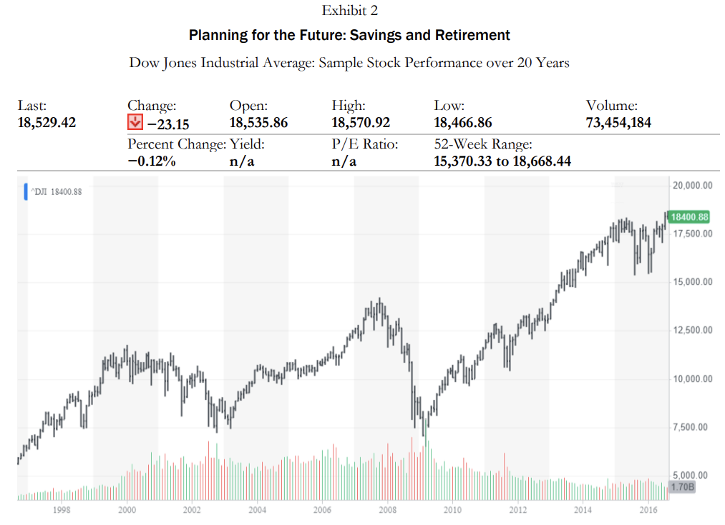
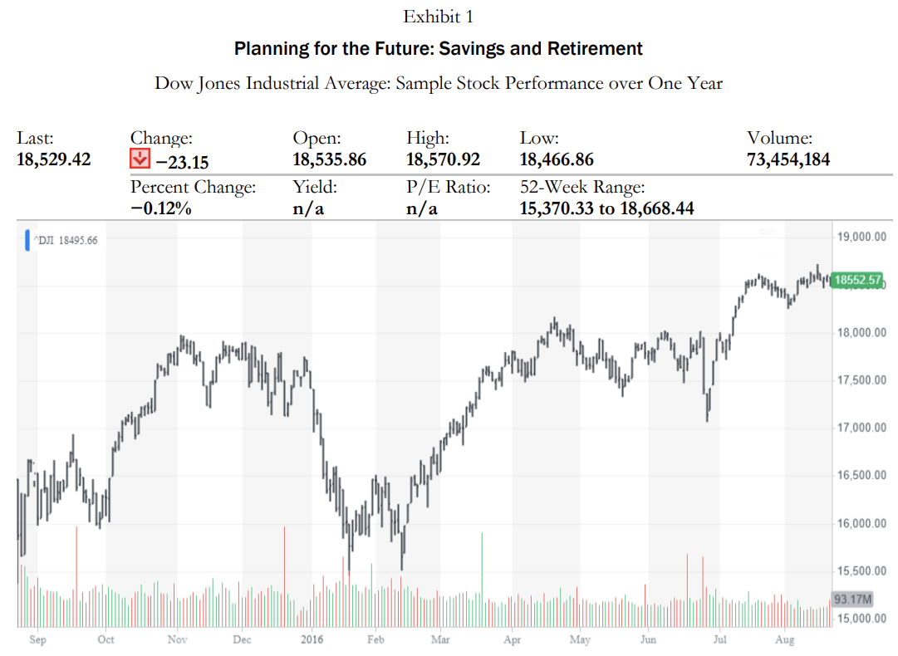
Important data

Slide 5
exhibit 1

Slide 6
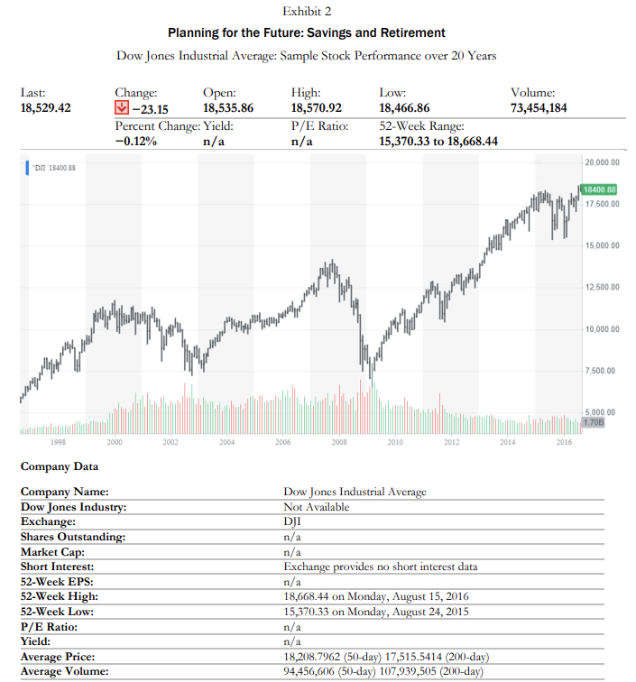
Exhibit 2

Slide 7
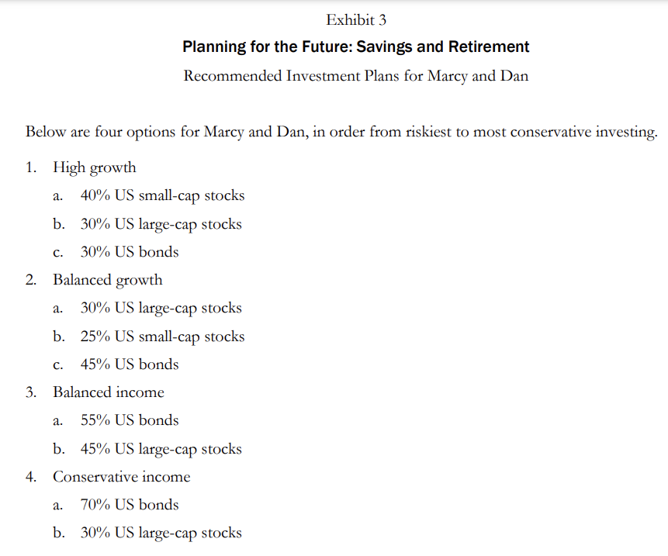
Exhibit 3

Slide 8
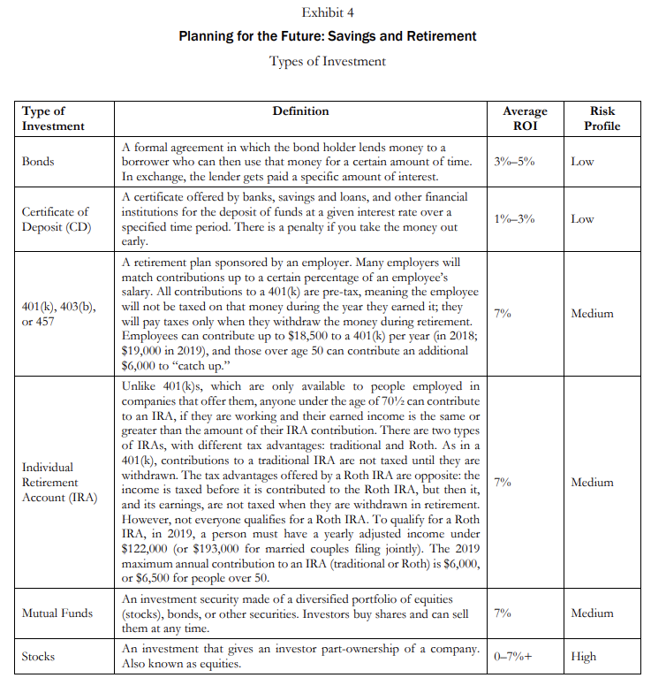
Exhibit 4

Slide 9
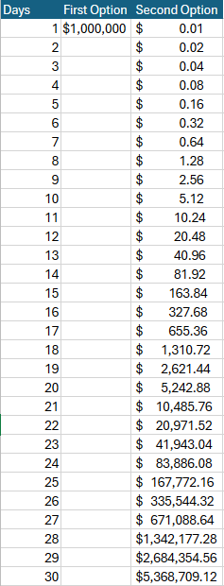
Case Writeup Answers
George had Marcy and Dan decide whether they would rather have 1$ m. today or receive a penny that doubled in price every day for 30 days. How much would they have if they took the penny option?
At the end of the 30 days, the amount would be $5,368,709.12.

Slide 10
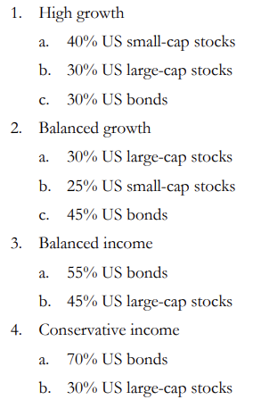
Which plan is best for Marcy and Dan?
The Conservative income plan, which is low risk. Bonds are favored over stocks in this plan (70% allocated to bonds), protecting against market volatility. Bonds would provide them a steady stream of income, and since the plan focuses on stability and income generation, they will not need to worry about market volatility.

Slide 11
Choose the best investment for the person who is 25 years old. Why? Will your answer change for someone who is 45 years old? 65 years old? Why?
The 25 year old is better off with stocks and equity mutual funds, which are better in the long term.
The 45 year old will do well if they diversify their portfolio from less stocks to more bonds and balanced funds.
A 65 year old is at retirement age and needs to go for conservative investments such as bonds, CDs, or annuities.

Slide 12

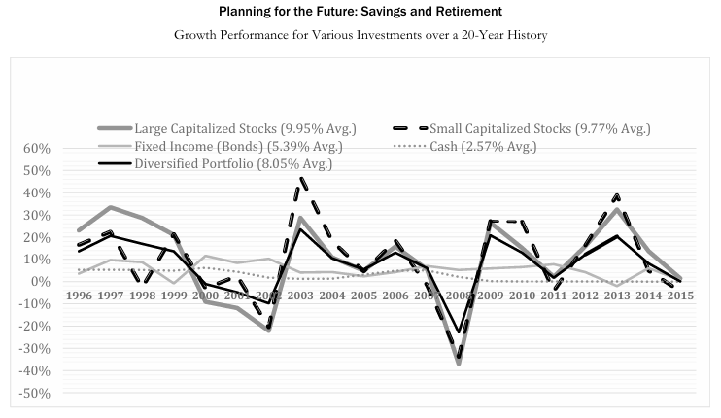
2024 vs 1996-2015 Investing and Pension Instruments

Slide 13
Indexes
Collection of a type of investment that tracks that category of investment’s performance and price level of index reflects general value
S&P500: an index of the top 500 companies
Russell 3000 Index: an index of the 1000 large capitalized stocks + 2000 mid-small capitalized stocks
Barclay’s Aggregated Bond Index: an index of many types of bonds and securities

Slide 14

Legend Breakdown
* Investment of $100,000
Large Capitalized Stocks: S&P500 Index Stocks
Small Capitalized Stock: Russell 2000 Index Stocks (The Russell Index)
Fixed Income (Bonds): Barclays Aggregate Bond Index, BBB rated or better 1 YTM
Diversified Portfolio: A mix of indexes (Barclays, an international index, and Russel indexes)
Cash: Treasury Bill 3-Month rate
Notes:
At maturity, the U.S. Treasury will pay you the face value of the bill, which is typically $1,000 per bill, and you will receive the interest earned over the three-month period.
A bond is when a borrower asks for money and pays you back with interest by the maturity rate
Barclays is an index of bonds and securities
Security = tradeable financial asset

Slide 15
1996-2015 Index performances as per the case study
Notes:
The percentage is the average growth in performance
Diversified is a stable option as its lows aren’t as low and its highs aren’t as high as other options
Cash and Bonds are very safe

Slide 16
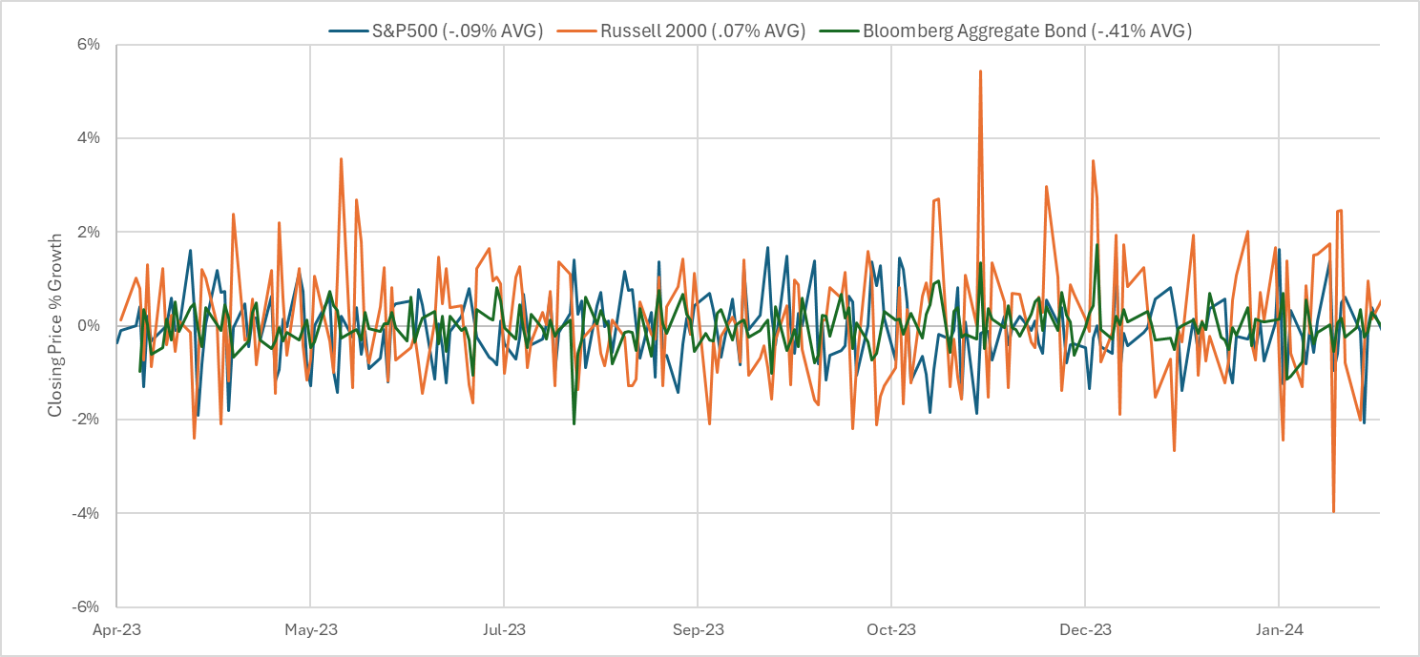
2024 Index Performances
Notes:
S&P500 somewhat stable but is operates on a small loss average
Bloomberg Aggregate Bond loses considerably more on average
Russell 2000 index expects small increases in growth on average

Slide 17

Pension and Pension Types
Pension: Payment to a retiree from and investment they or their employer contributed to
Direct benefit: regular monthly payment during retirement based on service or salary (regular pension)
Direct contribution: regular monthly payment during retirement based on employee and employer contributions and market (401k or Roth/Traditional IRA)
Notes:
IRA you can withdraw money made at 59 and a half, Roth has no tax penalty for withdrawals

Slide 18
Employers move to direct contributions (DC)
Employers moved to 401k DCs almost completely by December 2006
New regulations increased liability, tax, and admin costs of maintaining DBs since the 80s
Economy shifted from manufacturing to services and IT caused DB to be too pricy
Employees like the transferability of DCs
Notes:
DCs require companies to pay retirees no matter the market conditions and the government was making DCs less enticing
The new smaller and higher-skilled teams in the economy resulted in more demand of pension plans and the DBs were a good response to shift investment to employee
Employees would have more to lose with a DB is they leave the company to another one to basically start over their pension benefits at another company as it is based on years of service

Slide 19

Questions?

Slide 20
Sources
https://www.msci.com/www/index-factsheets/msci-eafe-index/07146631#:~:text=The%20MSCI%20EAFE%20Index%20is,market%20capitalization%20in%20each%20country.
https://ycharts.com/indicators/3_month_t_bill#:~:text=3%20Month%20Treasury%20Bill%20Rate%20is%20at%205.22%25%2C%20compared%20to,a%20maturity%20of%203%20months.
https://www.investopedia.com/terms/r/russell_3000.asp
https://www.investopedia.com/terms/r/russell2000.asp
https://www.nerdwallet.com/article/banking/banking-basics/understanding-small-cap-stocks#:~:text=Small%2Dcap%20stocks%20are%20company,Market%20Cap%20Explained.&text=%22Cap%22%20is%20shorthand%20for%20market,by%20its%20current%20stock%20price.
https://www.investopedia.com/terms/l/large-cap.asp
https://www.investopedia.com/terms/s/sp500.asp
https://capital.com/barclays-capital-aggregate-bond-index-definition#:~:text=This%20index%20is%20commonly%20used,the%20fixed%2Dincome%20investments%20market.
https://www.investor.gov/introduction-investing/investing-basics/investment-products/bonds-or-fixed-income-products/bonds
https://www.fidelity.com/learning-center/investment-products/fixed-income-bonds/bond-ratings
https://finance.yahoo.com/quote/%5EGSPC/
https://finance.yahoo.com/quote/%5ERUT/
https://www.marketwatch.com/investing/index/spx/download-data
https://finance.yahoo.com/quote/USAG.L/history/
https://en.wikipedia.org/wiki/Security_(finance)
https://www.ssa.gov/policy/docs/ssb/v69n3/v69n3p1.html

